Slide 1
AP Exam Review
Mrs. Ashley

Slide 2
9-1 What Role Do Humans Play in the Extinction of Species?
Concept 9-1 Species are becoming extinct 100 to 1,000 times faster than they were before modern humans arrived on the earth (the background rate), and by the end of this century, the extinction rate is expected to be 10,000 times the background rate.

Slide 3
Endangered and Threatened Species Are Ecological Smoke Alarms (1)
Endangered species
So few members that the species could soon become extinct
Threatened species (vulnerable species)
Still enough members to survive, but numbers declining -- may soon be endangered

Slide 4
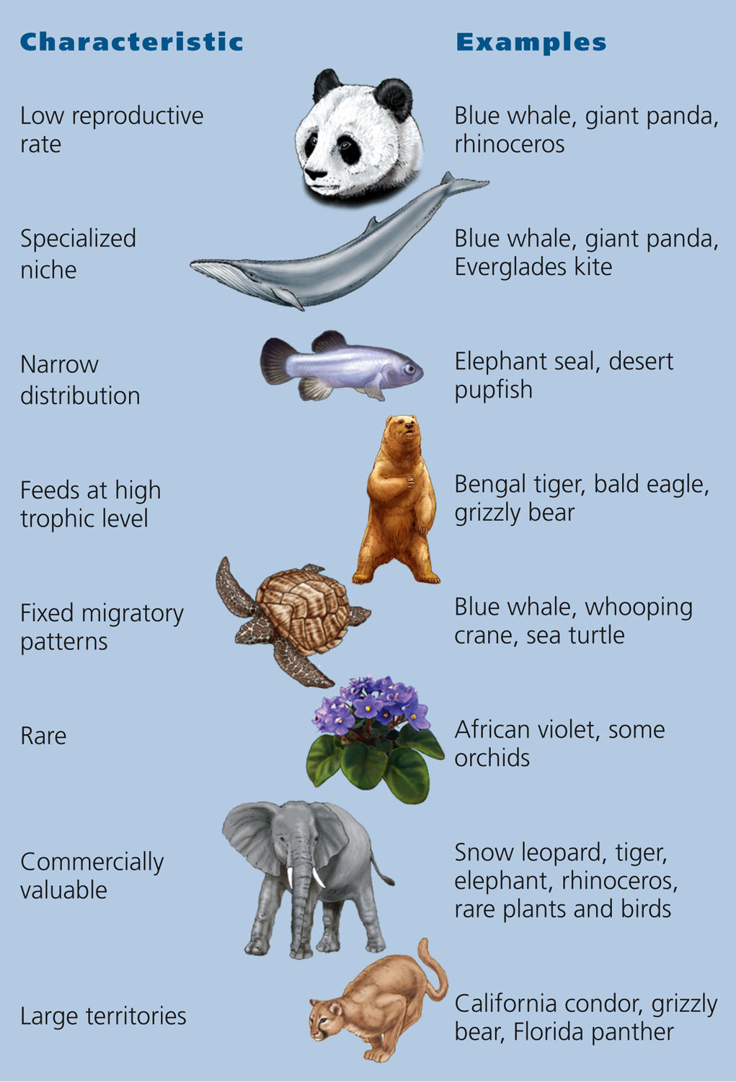
Characteristics of Species That Are Prone to Ecological and Biological Extinction
Fig. 9-3, p. 194
Notes:
Figure 9.3: This diagram shows the characteristics of species that can put them in greater danger of becoming extinct. Question: Which of these characteristics might possibly contribute to the extinction of the polar bear (Core Case study) during this century?

Slide 5
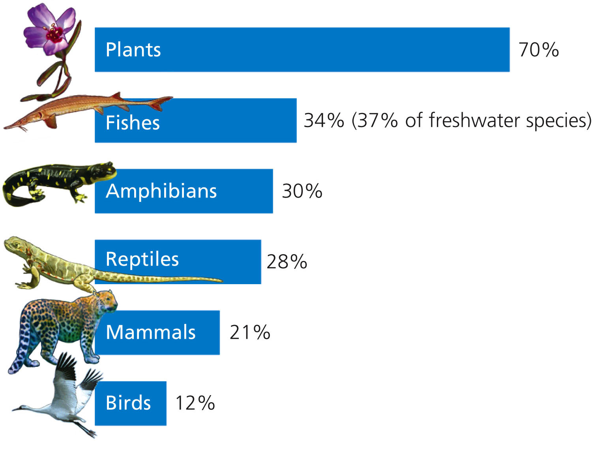
Percentage of Various Species Threatened with Premature Extinction
Fig. 9-4, p. 194
Notes:
Figure 9.4: Endangered natural capital.
This graph shows the estimated percentages of various types of known species that are threatened with extinction because of human activities (Concept 9-1). Question: Why do you think plants (see Photo 4 in the Detailed Contents) and fish species top this list? (Data from International Union for Conservation of Nature, Conservation 2009)

Slide 6
9-2 Why Should We Care about the Rising Rate of Species Extinction?
Concept 9-2 We should prevent the premature extinction of wild species because of the economic and ecological services they provide and because they have a right to exist regardless of their usefulness to us.

Slide 7
9-3 How do Humans Accelerate Species Extinction?
Concept 9-3 The greatest threats to any species are (in order) loss or degradation of its habitat, harmful invasive species, human population growth, pollution, climate change, and overexploitation.

Slide 8
Loss of Habitat Is the Single Greatest Threat to Species: Remember HIPPCO
Habitat destruction, degradation, and fragmentation
Invasive (nonnative) species
Population and resource use growth
Pollution
Climate change
Overexploitation

Slide 9
Habitat Fragmentation
Habitat fragmentation
Large intact habitat divided by roads, crops, urban development
Leaves habitat islands
Blocks migration routes
Divides populations
Inhibits migrations and colonization
Inhibits finding food
National parks and nature reserves as habitat islands

Slide 10
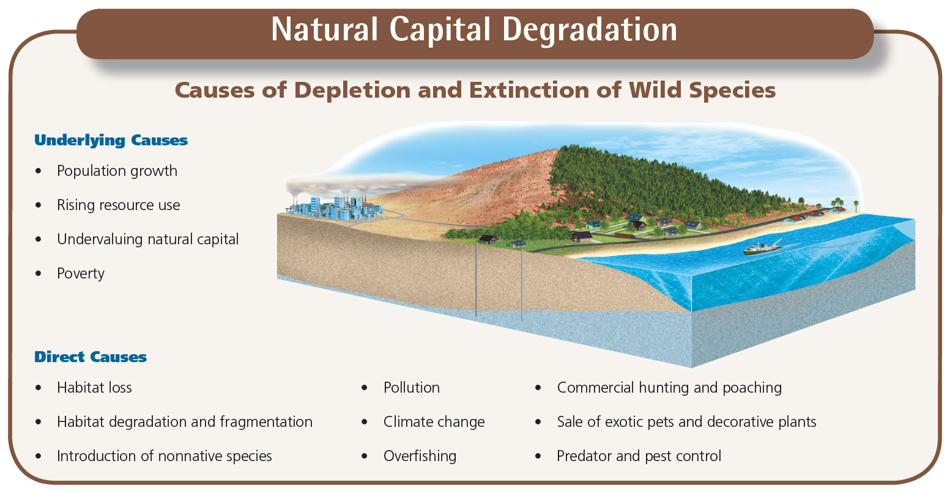
Causes of Depletion and Premature Extinction of World Species
Fig. 9-9, p. 198
Notes:
Figure 9.9: This figure illustrates both the underlying and direct causes of depletion and extinction of wild species resulting from human activities (Concept 9-3) (see Figure 1-9, p. 13). The biggest cause is habitat loss, degradation, and fragmentation. This is followed by the deliberate or accidental introduction of harmful invasive (nonnative) species into ecosystems. Question: What are two direct causes that are specifically related to each of the underlying causes?

Slide 11
Some Deliberately Introduced Species Can Disrupt Ecosystems
Most species introductions are beneficial
Food
Shelter
Medicine
Aesthetic enjoyment
Nonnative species may have no natural
Predators
Competitors
Parasites
Pathogens

Slide 12
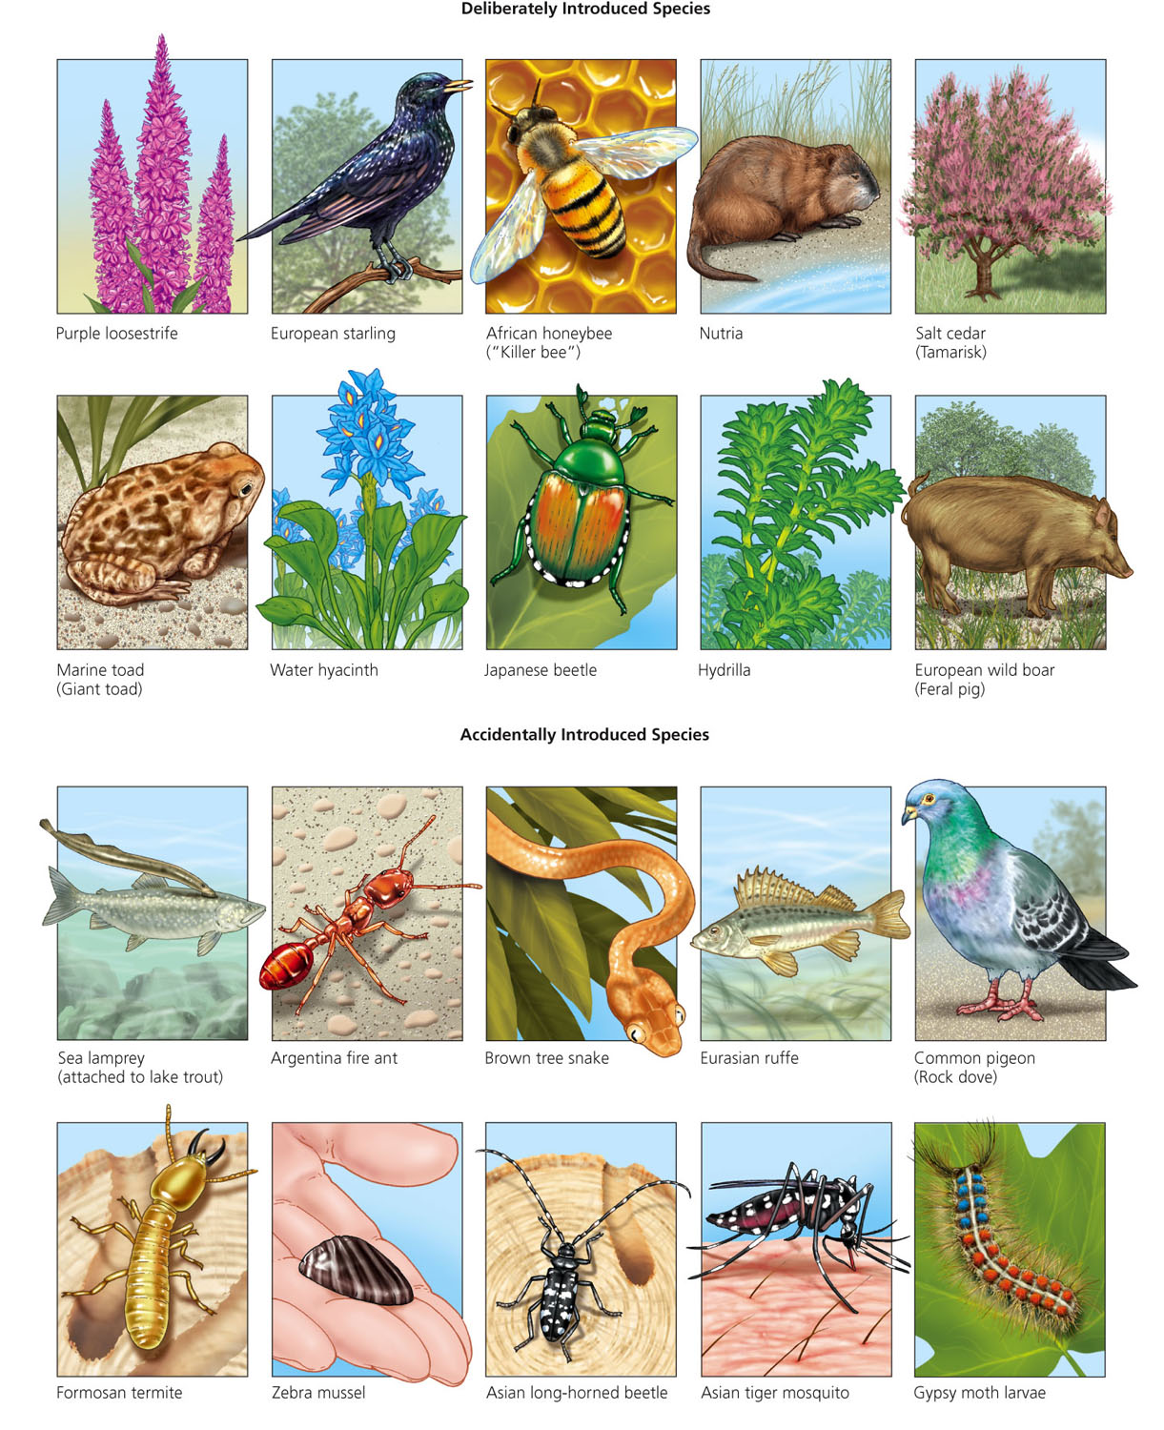
Some Harmful Nonnative Species in the United States
Fig. 9-11, p. 200
Notes:
Figure 9.11: These are some of the more than 7,100 harmful invasive (nonnative) species that have been deliberately or accidentally introduced into the United States.

Slide 13
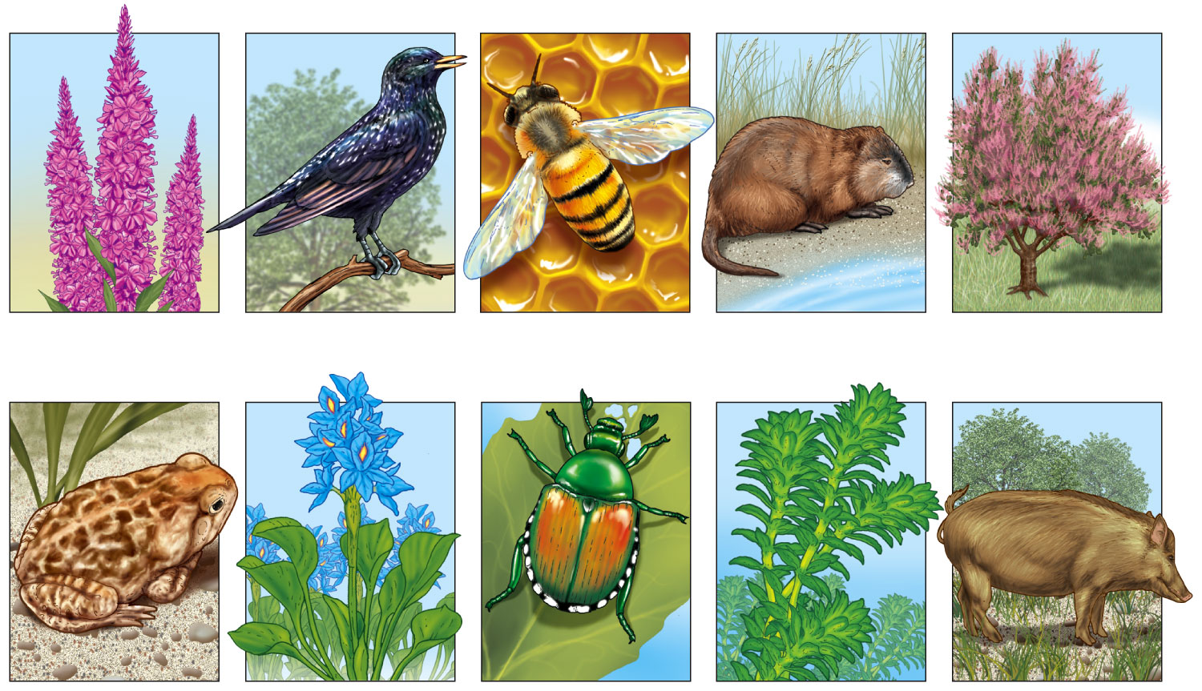
Deliberately Introduced Species
Purple loosestrife
European starling
African honeybee (“Killer bee”)
Nutria
Salt cedar (Tamarisk)
Marine toad (Giant toad)
Water hyacinth
Japanese beetle
Hydrilla
European wild boar (Feral pig)
Fig. 9-11a, p. 200
Notes:
Figure 9.11: These are some of the more than 7,100 harmful invasive (nonnative) species that have been deliberately or accidentally introduced into the United States.

Slide 14
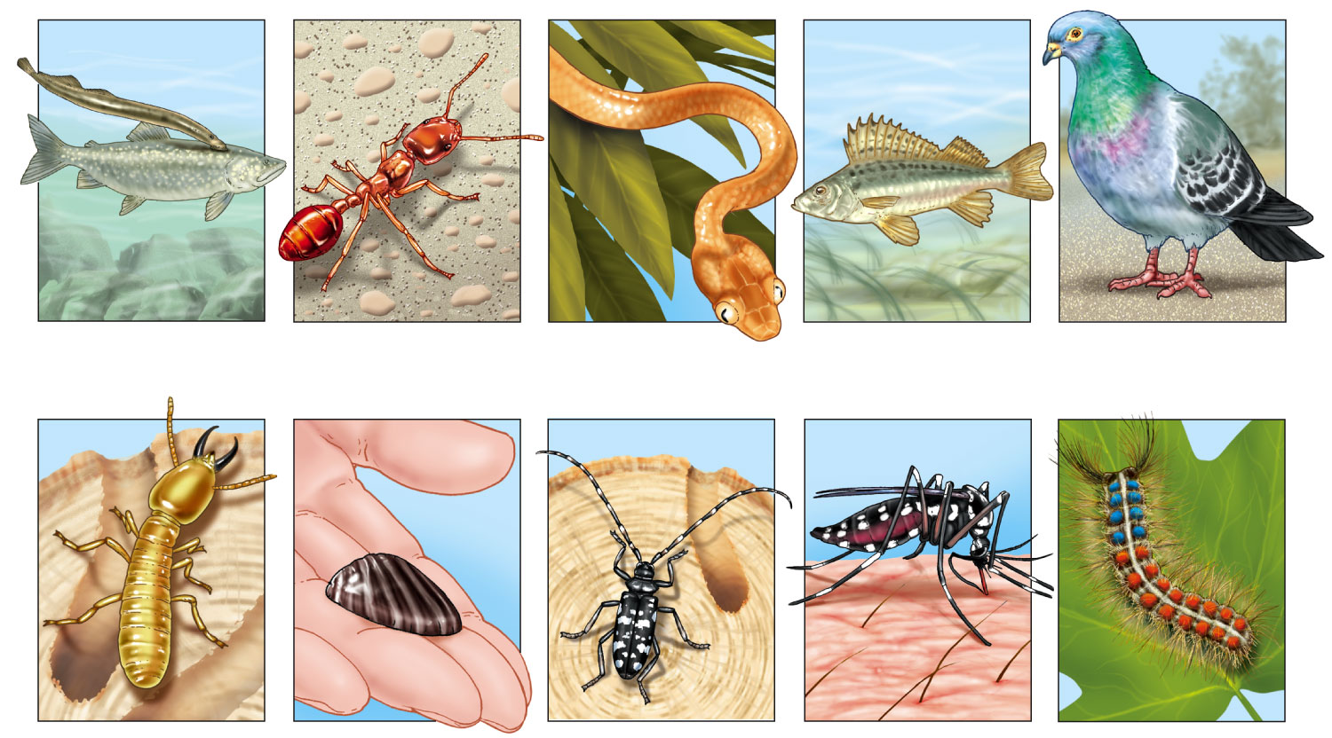
Accidentally Introduced Species
Sea lamprey (attached to lake trout)
Argentina fire ant
Brown tree snake
Eurasian ruffe
Common pigeon (Rock dove)
Formosan termite
Zebra mussel
Asian long-horned beetle
Asian tiger mosquito
Gypsy moth larvae
Fig. 9-11b, p. 200
Notes:
Figure 9.11: These are some of the more than 7,100 harmful invasive (nonnative) species that have been deliberately or accidentally introduced into the United States.

Slide 15
Prevention Is the Best Way to Reduce Threats from Invasive Species
Prevent them from becoming established
Learn the characteristics of the species
Set up research programs
Try to find natural ways to control them
International treaties
Public education

Slide 16
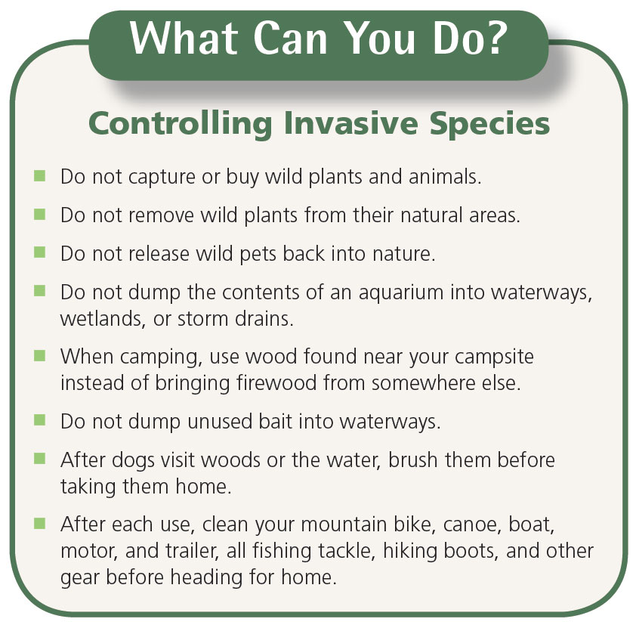
What Can You Do? Controlling Invasive Species
Fig. 9-14, p. 203
Notes:
Figure 9.14: Individuals matter.
Here is a list of some ways to prevent or slow the spread of harmful invasive species. Questions: Which two of these actions do you think are the most important? Why? Which of these actions do you plan to take?

Slide 17
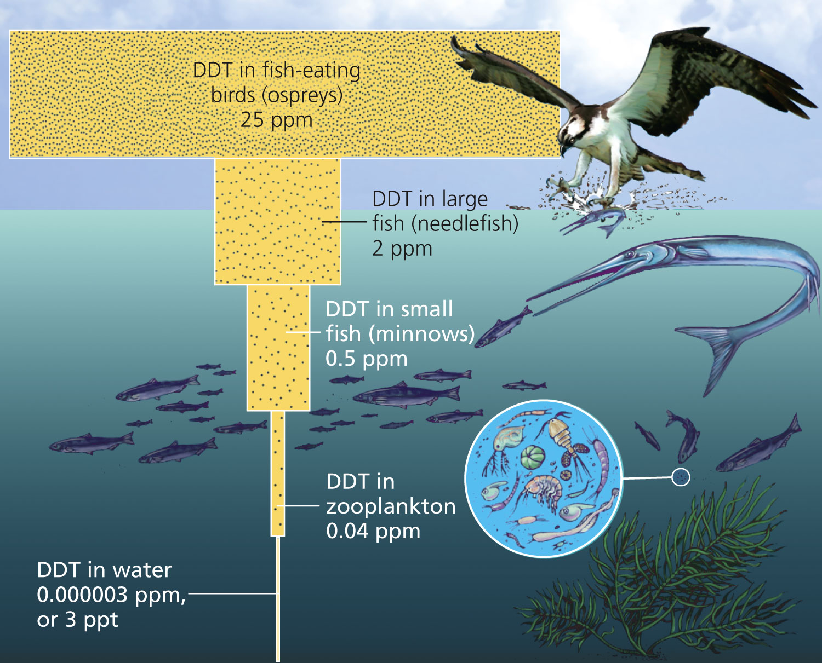
Bioaccumulation and Biomagnification
Fig. 9-15, p. 203
Notes:
Figure 9.15: Bioaccumulation and biomagnification: DDT is a fat-soluble chemical that can accumulate in the fatty tissues of animals. In a food chain or web, the accumulated DDT is biologically magnified in the bodies of animals at each higher trophic level. (Dots in this figure represent DDT.) The concentration of DDT in the fatty tissues of organisms was biomagnified about 10 million times in this food chain in an estuary near Long Island Sound in the U.S. state of New York. If each phytoplankton organism takes up and retains one unit of DDT, a small fish eating thousands of zooplankton (which feed on the phytoplankton) will store thousands of units of DDT in its fatty tissue. Each large fish that eats ten of the smaller fish will ingest and store tens of thousands of units, and each bird (or human) that eats several large fish will ingest hundreds of thousands of units. Question: How does this story demonstrate the value of pollution prevention?

Slide 18
Case Study: Where Have All the Honeybees Gone?
Honeybees responsible for 80% of insect-pollinated plants and nearly 1/3 human food
2006: 30% drop in honeybee populations
Dying due to
Pesticides?
Parasites?
Viruses, fungi, bacteria?
Microwave radiation – cell phones?
Bee colony collapse syndrome

Slide 19
Case Study: A Disturbing Message from the Birds (1)
1/3 of 800 bird species in U.S. are endangered or threatened
Habitat loss and fragmentation of the birds’ breeding habitats
Forests cleared for farms, lumber plantations, roads, and development
Intentional or accidental introduction of nonnative species
Eat the birds

Slide 20
Case Study: A Disturbing Message from the Birds (2)
Seabirds caught and drown in fishing equipment
Migrating birds fly into power lines, communication towers, and skyscrapers
Other threats
Oil spills
Pesticides
Herbicides
Ingestion of toxic lead shotgun pellets

Slide 21
Case Study: A Disturbing Message from the Birds (3)
Greatest new threat: Climate change
Environmental indicators
Economic and ecological services

Slide 22
International Treaties and National Laws Help to Protect Species
1975: Convention on International Trade in Endangered Species (CITES)
Signed by 172 countries
Convention on Biological Diversity (BCD)
Focuses on ecosystems
Ratified by 190 countries (not the U.S.)

Slide 23
Endangered Species Act
Endangered Species Act (ESA): 1973 and later amended in 1982, 1985, and 1988
Identify and protect endangered species in the U.S. and abroad
National Marine Fisheries Service for ocean species
U.S. Fish and Wildlife Service for all others

Slide 24
Science Focus: Accomplishments of the Endangered Species Act (2)
Three ways to improve ESA
Greatly increase funding
Develop recovery plans more quickly
When a species is first listed, establish the core of its habitat that’s critical for survival
New law needed to focus on sustaining biodiversity and ecosystem health

Slide 25
We Can Establish Wildlife Refuges and Other Protected Areas
1903: Theodore Roosevelt
Wildlife refuges
Most are wetland sanctuaries
More needed for endangered plants
Could abandoned military lands be used for wildlife habitats?

Slide 26
Gene Banks, Botanical Gardens, and Wildlife Farms Can Help Protect Species
Gene or seed banks
Preserve genetic material of endangered plants
Botanical gardens and arboreta
Living plants
Farms to raise organisms for commercial sale

Slide 27
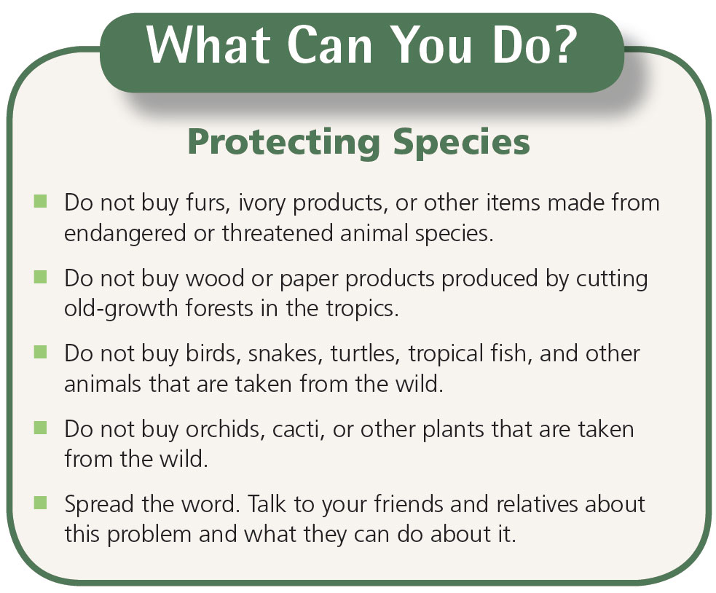
What Can You Do? Protecting Species
Fig. 9-22, p. 213
Notes:
Figure 9.22: Individuals matter.
You can help prevent the extinction of species. Questions: Which two of these actions do you believe are the most important? Why?

Slide 28
The Precautionary Principle
Precautionary principle: act to prevent or reduce harm when preliminary evidence indicates acting is needed
Species: primary components of biodiversity
Preservation of species
Preservation of ecosystems

Slide 29
7-1 What Factors Influence Climate?
Concept 7-1 Key factors that determine an area’s climate are incoming solar energy, the earth’s rotation, global patterns of air and water movement, gases in the atmosphere, and the earth’s surface features.

Slide 30
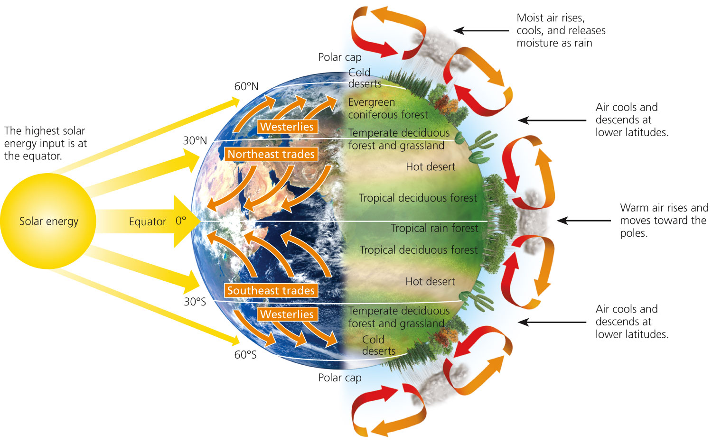
Global Air Circulation
Fig. 7-3, p. 149
Notes:
Figure 7.3: Global air circulation: The largest input of solar energy occurs at the equator. As this air is heated, it would naturally rise and move toward the poles (left). However, the earth’s rotation deflects this movement of the air over different parts of the earth. This creates global patterns of prevailing winds that help to distribute heat and moisture in the atmosphere and result in the earth’s variety of forests, grasslands, and deserts (right).

Slide 31
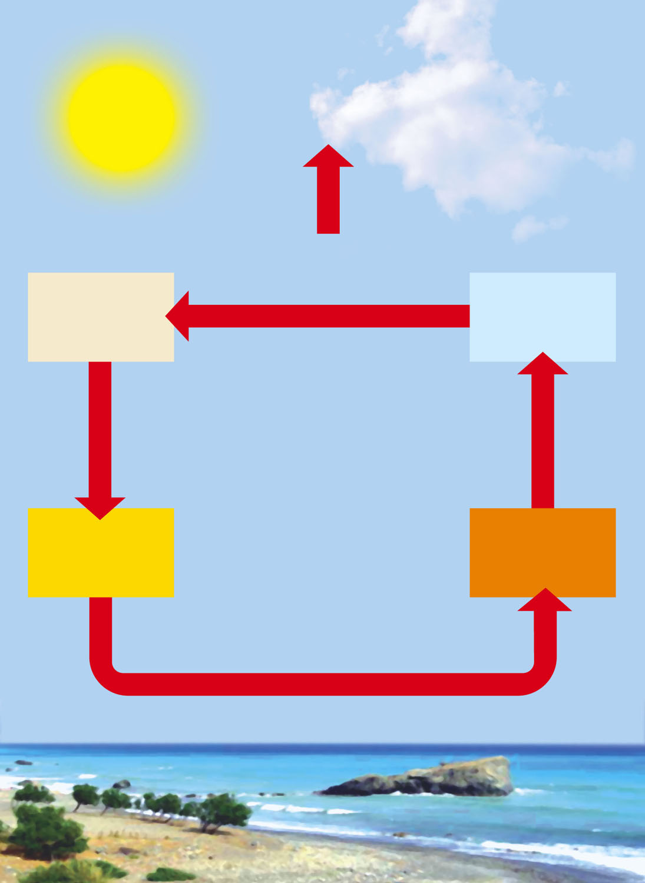
LOW PRESSURE
HIGH PRESSURE
Heat released radiates to space
Cool, dry air
Condensation and precipitation
Falls, is compressed, warms
Rises, expands, cools
Warm, dry air
Hot, wet air
Flows toward low pressure, picks up moisture and heat
HIGH PRESSURE
LOW PRESSURE
Moist surface warmed by sun
Fig. 7-4, p. 150
Notes:
Figure 7.4: This diagram illustrates energy transfer by convection in the atmosphere. Convection occurs when warm, wet air rises, then cools and releases heat and moisture as precipitation (right side and top, center). Then the cooler, denser, and drier air sinks, warms up, and absorbs moisture as it flows across the earth’s surface (bottom) to begin the cycle again.

Slide 32
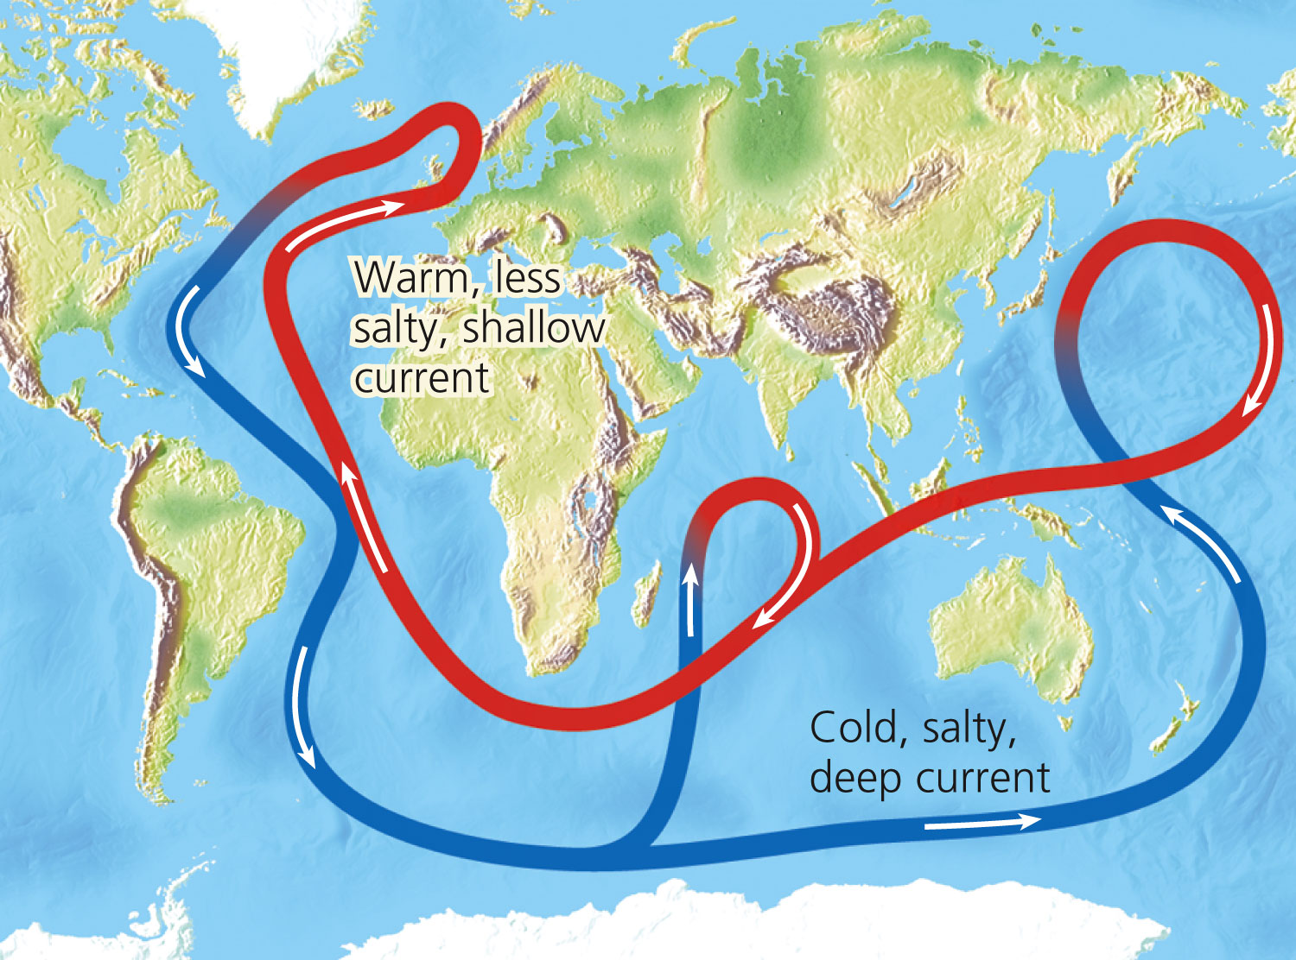
Connected Deep and Shallow Ocean Currents
Fig. 7-5, p. 150
Notes:
Figure 7.5: Connected deep and shallow ocean currents: A connected loop of shallow and deep ocean currents transports warm and cool water to various parts of the earth. This loop, which rises in some areas and falls in others, results when ocean water in the North Atlantic near Iceland is dense enough (because of its salt content and cold temperature) to sink to the ocean bottom, flow southward, and then move eastward to well up in the warmer Pacific. A shallower return current, aided by winds, then brings warmer, less salty, and thus less dense water to the Atlantic. This water then cools and sinks to begin this extremely slow cycle again. Question: How do you think this loop affects the climates of the coastal areas around it?

Slide 33
The Earth Has Many Different Climates (3)
El Niño-Southern Oscillation
Every few years
Prevailing winds in tropical Pacific Ocean change direction
Affects much of earth’s weather for 1-2 years
Link between air circulation, ocean currents, and biomes

Slide 34
Normal and El Niño Conditions
Figure 4, Supplement 7

Slide 35
Greenhouse Gases Warm the Lower Atmosphere
Greenhouse gases
H₂O
CO₂
CH₄
N₂O
Natural greenhouse effect
Gases keep earth habitable
Human-enhanced global warming

Slide 36
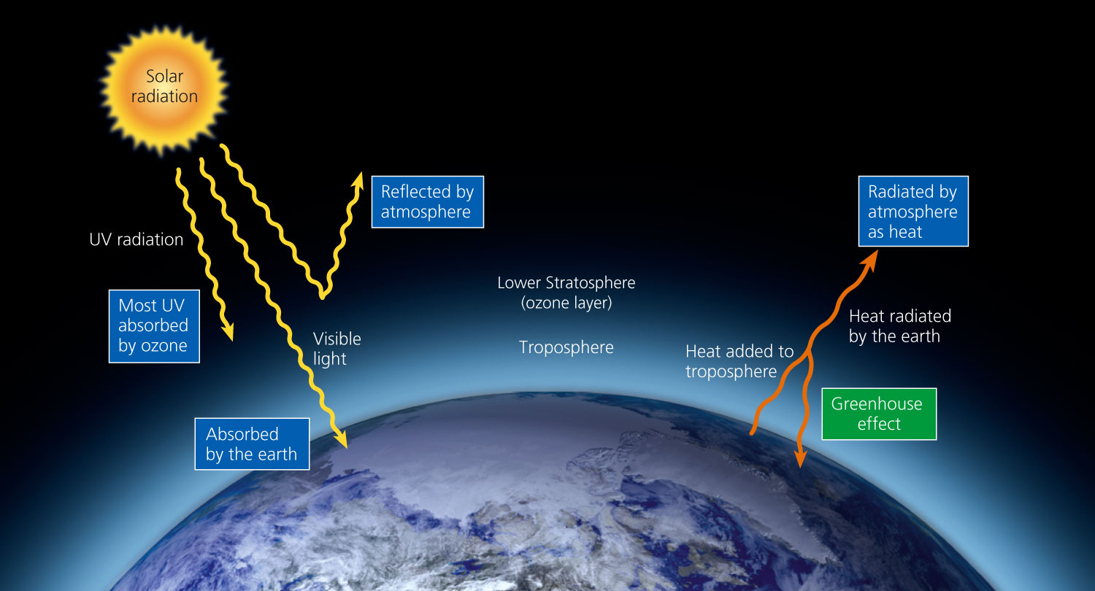
Flow of Energy to and from the Earth
Fig. 3-4, p. 57
Notes:
Figure 3.4: High-quality solar energy flows from the sun to the earth. As it interacts with the earth’s air, water, soil, and life, it is degraded into lower-quality energy (heat) that flows back into space.

Slide 37
Earth’s Surface Features Affect Local Climates
Differential heat absorption by land and water
Land and sea breezes
Rain shadow effect
Most precipitation falls on the windward side of mountain ranges
Deserts leeward
Cities create microclimates

Slide 38
Climate Helps Determine Where Organisms Can Live
Major biomes: large land regions with certain types of climate and dominant plant life
Not uniform
Mosaic of patches
Latitude and elevation
Annual precipitation
Temperature

Slide 39
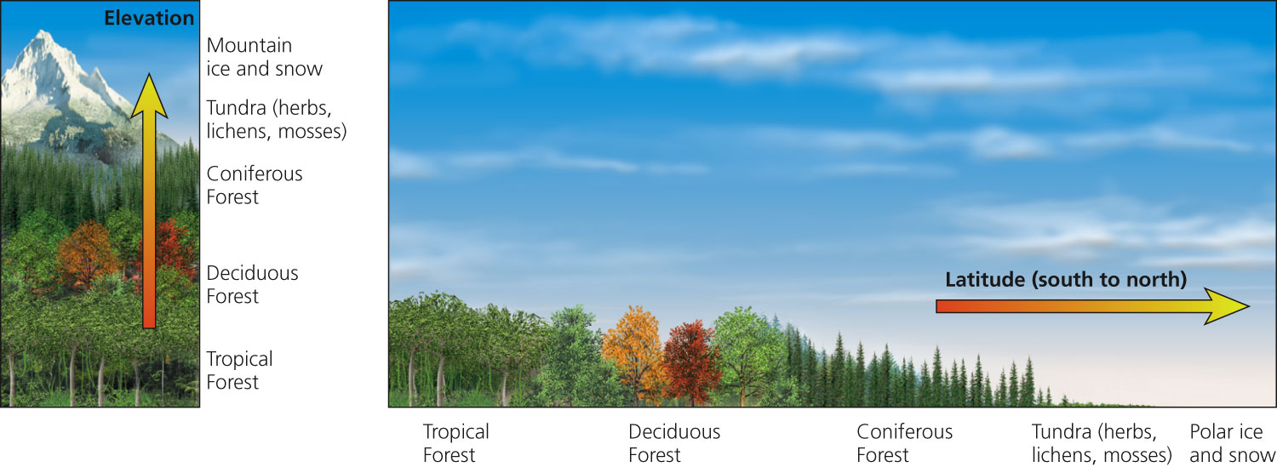
Generalized Effects of Elevation and Latitude on Climate and Biomes
Fig. 7-8, p. 153
Notes:
Figure 7.8: This diagram shows the generalized effects of elevation (left) and latitude (right) on climate and biomes (Core Case study). Parallel changes in vegetation type occur when we travel from the equator toward the north pole and from lowlands to mountaintops. Question: How might the components of the left diagram change as the earth warms during this century? Explain.

Slide 40
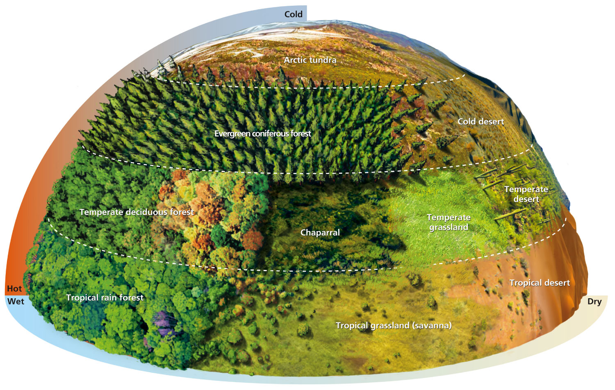
Natural Capital: Average Precipitation and Average Temperature as Limiting Factors
Fig. 7-9, p. 154
Notes:
Figure 7.9: Natural capital.
This diagram demonstrates that average precipitation and average temperature, acting together as limiting factors over a long time, help to determine the type of desert, grassland, or forest in a particular area, and thus the types of plants, animals, and decomposers found in that area (assuming it has not been disturbed by human activities).

Slide 41
There Are Three Major Types of Deserts
Tropical deserts
Temperate deserts
Cold deserts
Fragile ecosystem
Slow plant growth
Low species diversity
Slow nutrient recycling
Lack of water

Slide 42
Science Focus: Staying Alive in the Desert
Beat the heat/every drop of water counts
Plant adaptations
Succulents
Deep tap roots
Animal strategies and adaptations
Physiology and anatomy
Behavior

Slide 43
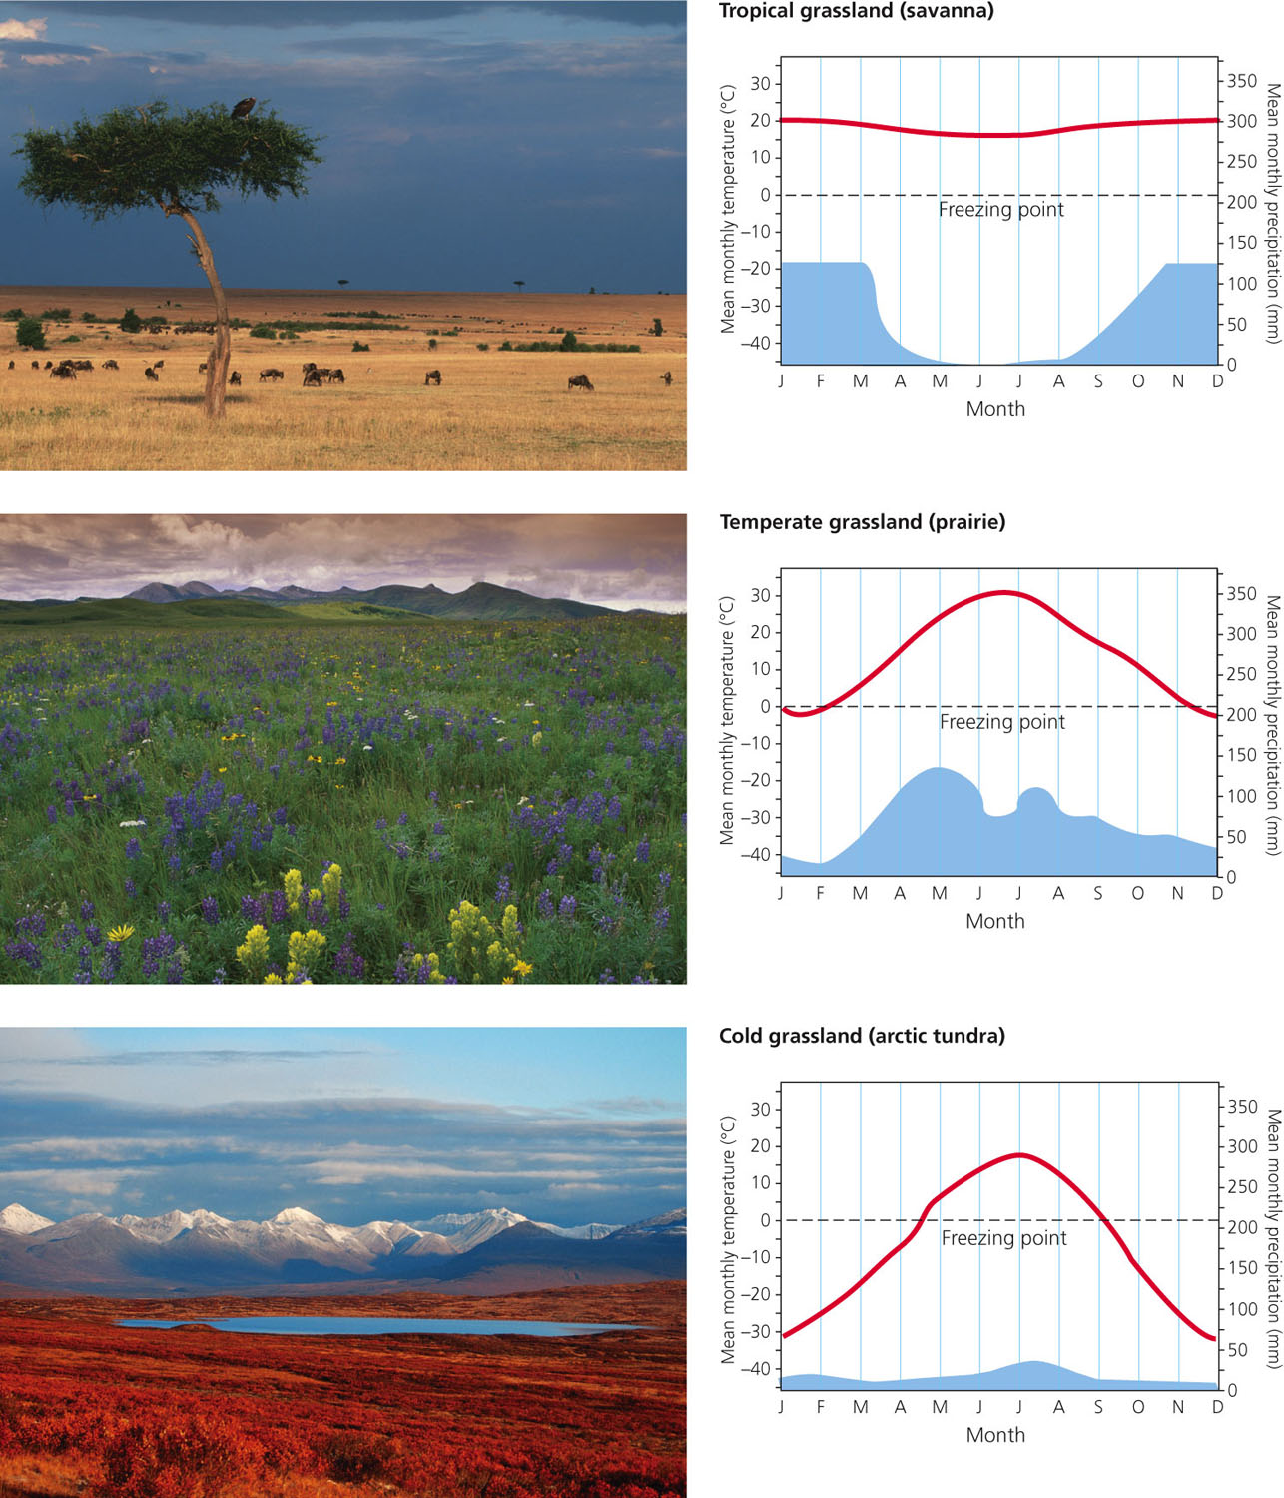
Climate Graphs of Tropical, Temperate, and Cold Grasslands
Fig. 7-11, p. 157
Notes:
Figure 7.11: These climate graphs track the typical variations in annual temperature (red) and precipitation (blue) in tropical, temperate, and cold (arctic tundra) grasslands. Top photo: savanna (tropical grassland) in Maasai Mara National Park in Kenya, Africa, with wildebeests grazing. Center photo: prairie (temperate grassland) near East Glacier Park in the U.S. state of Montana, with wildflowers in bloom. Bottom photo: arctic tundra (cold grassland) in autumn in the U.S. state of Alaska (see also Figure 7-1, bottom). Question: What month of the year has the highest temperature and the lowest rainfall for each of the three types of grassland?

Slide 44
There Are Three Major Types of Grasslands (3)
Arctic tundra: fragile biome
Plants close to ground to conserve heat
Most growth in short summer
Animals have thick fur
Permafrost
Underground soil that stays frozen
Alpine tundra: above tree line in mountains

Slide 45
There Are Three Major Types of Forests (1)
Tropical
Temperate
Cold
Northern coniferous and boreal

Slide 46
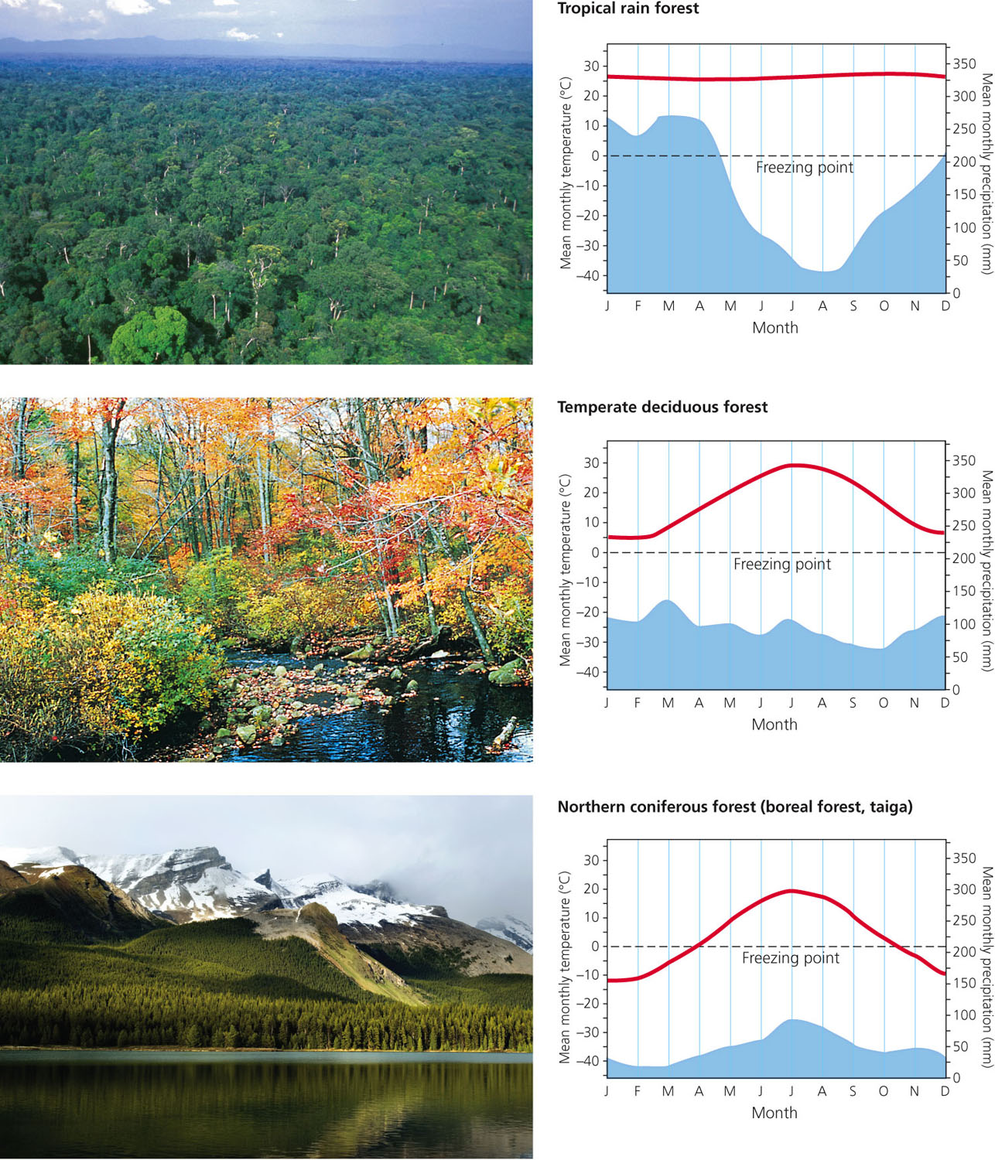
Climate Graphs of Tropical, Temperate, and Cold Forests
Fig. 7-13, p. 160
Notes:
Figure 7.13: These climate graphs track the typical variations in annual temperature (red) and precipitation (blue) in tropical, temperate, and cold (northern coniferous, or boreal) forests. Top photo: the closed canopy of a tropical rain forest in the western Congo Basin of Gabon, Africa. Middle photo: a temperate deciduous forest in the U.S. state of Rhode Island during the fall. (Photo 1 in the Detailed Contents shows this same area of forest during winter when its trees have lost their leaves.) Bottom photo: a northern coniferous forest in Canada’s Jasper National Park. Question: What month of the year has the highest temperature and the lowest rainfall for each of the three types of forest?

Slide 47
There Are Three Major Types of Forests (2)
Tropical rain forests
Temperature and moisture
Stratification of specialized plant and animal niches
Little wind: significance
Rapid recycling of scarce soil nutrients
Impact of human activities

Slide 48
There Are Three Major Types of Forests (3)
Temperate deciduous forests
Temperature and moisture
Broad-leaf trees
Slow rate of decomposition: significance
Impact of human activities

Slide 49
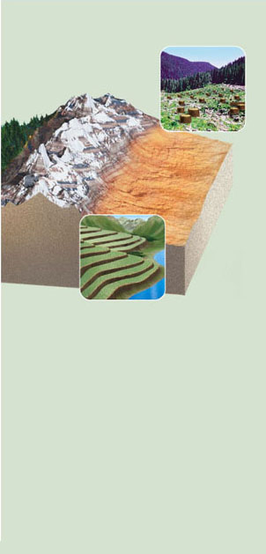
NATURAL CAPITAL DEGRADATION
Major Human Impacts on Terrestrial Ecosystems
Deserts
Grasslands
Forests
Mountains
Large desert cities
Conversion to cropland
Clearing for agriculture, livestock grazing, timber, and urban development
Agriculture
Timber extraction
Soil destruction by off-road vehicles
Release of CO₂ to atmosphere from burning grassland
Mineral extraction
Hydroelectric dams and reservoirs
Soil salinization from irrigation
Conversion of diverse forests to tree plantations
Increasing tourism
Depletion of groundwater
Overgrazing by livestock
Urban air pollution
Damage from off-road vehicles
Increased ultraviolet radiation from ozone depletion
Land disturbance and pollution from mineral extraction
Oil production and off-road vehicles in arctic tundra
Pollution of forest streams
Soil damage from off-road vehicles
Stepped Art
Fig. 7-18, p. 165

Slide 50
10-1 What Are the Major Threats to Forest Ecosystems?
Concept 10-1A Forest ecosystems provide ecological services far greater in value than the value of raw materials obtained from forests.
Concept 10-1B Unsustainable cutting and burning of forests, along with diseases and insects, all made worse by projected climate change, are the chief threats to forest ecosystems.

Slide 51
Forests Vary in Their Make-Up, Age, and Origins
Old-growth or primary forest (36%)
Uncut, or not disturbed for several hundred years
Reservoirs of biodiversity
Second-growth forest (60%)
Secondary ecological succession
Tree plantation, (tree farm, commercial forest) (4%)
May supply most industrial wood in the future

Slide 52
Forests Provide Important Economic and Ecological Services (1)
Support energy flow and chemical cycling
Reduce soil erosion
Absorb and release water
Purify water and air
Influence local and regional climate
Store atmospheric carbon
Habitats

Slide 53
Forests Provide Important Economic and Ecological Services (2)
Wood for fuel
Lumber
Pulp to make paper
Mining
Livestock grazing
Recreation
Employment

Slide 54
Natural Capital
Forests
Ecological Services
Economic Services
Support energy flow and chemical cycling
Fuelwood
Reduce soil erosion
Lumber
Absorb and release water
Pulp to make paper
Purify water and air
Mining
Influence local and regional climate
Livestock grazing
Store atmospheric carbon
Recreation
Provide numerous wildlife habitats
Jobs
Fig. 10-4, p. 220
Notes:
Figure 10.4: Forests provide many important ecological and economic services (Concept 10-1a). Question: Which two ecological services and which two economic services do you think are the most important?

Slide 55
Science Focus: Putting a Price Tag on Nature’s Ecological Services
Forests valued for ecological services
Nutrient cycling
Climate regulation
Erosion control
Waste treatment
Recreation
Raw materials
$4.7 trillion per year

Slide 56
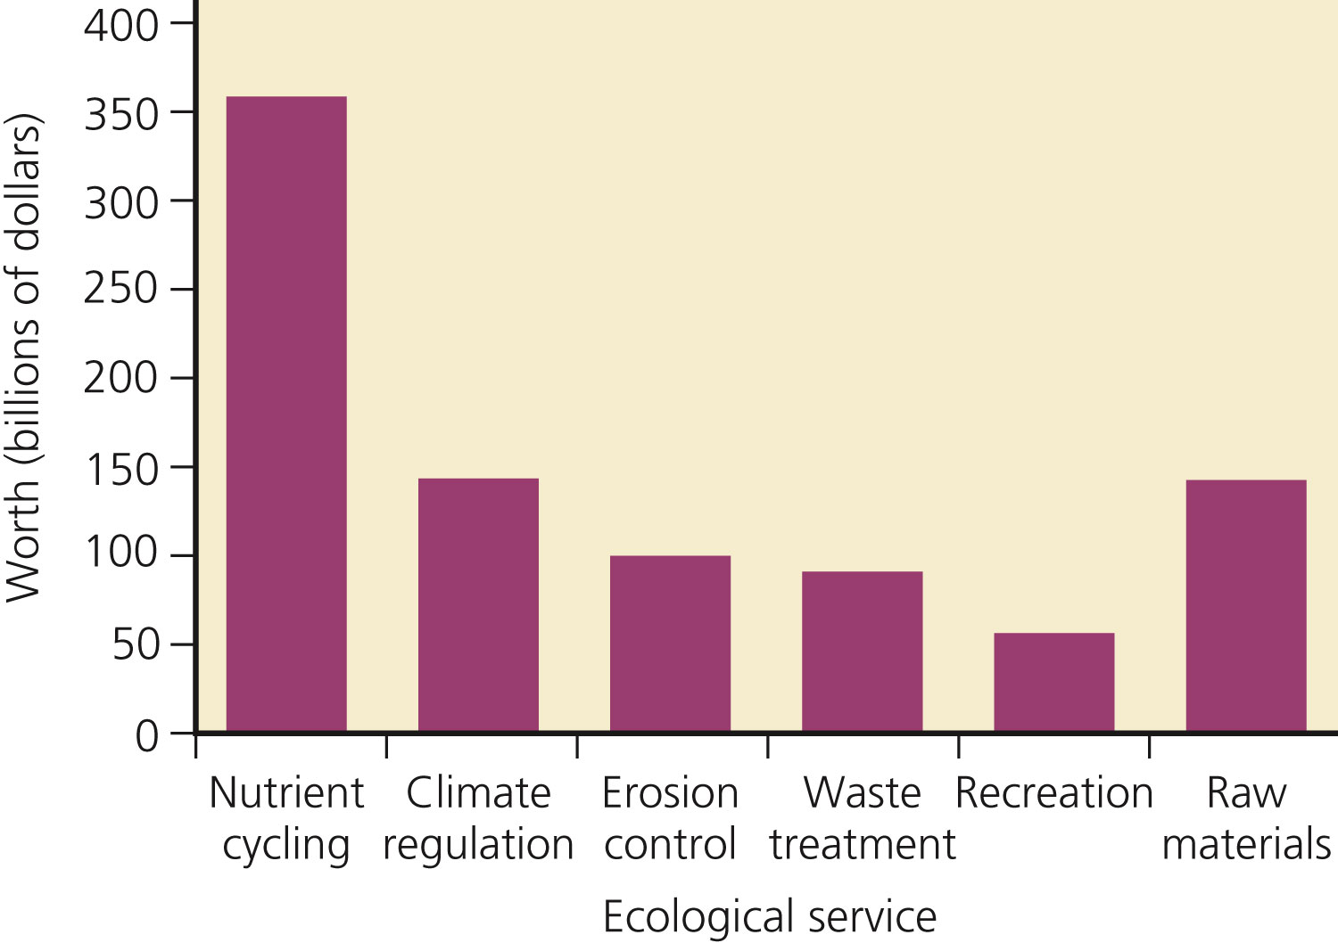
Estimated Annual Global Economic Values of Ecological Services Provided by Forests
Fig. 10-A, p. 221
Notes:
Figure 10.A: This chart shows estimates of the annual global economic values of some ecological services provided by forests compared to the raw materials they produce (in billions of dollars). (Data from Robert Costanza)

Slide 57
Unsustainable Logging is a Major Threat to Forest Ecosystems (1)
Increased erosion
Sediment runoff into waterways
Habitat fragmentation
Loss of biodiversity

Slide 58
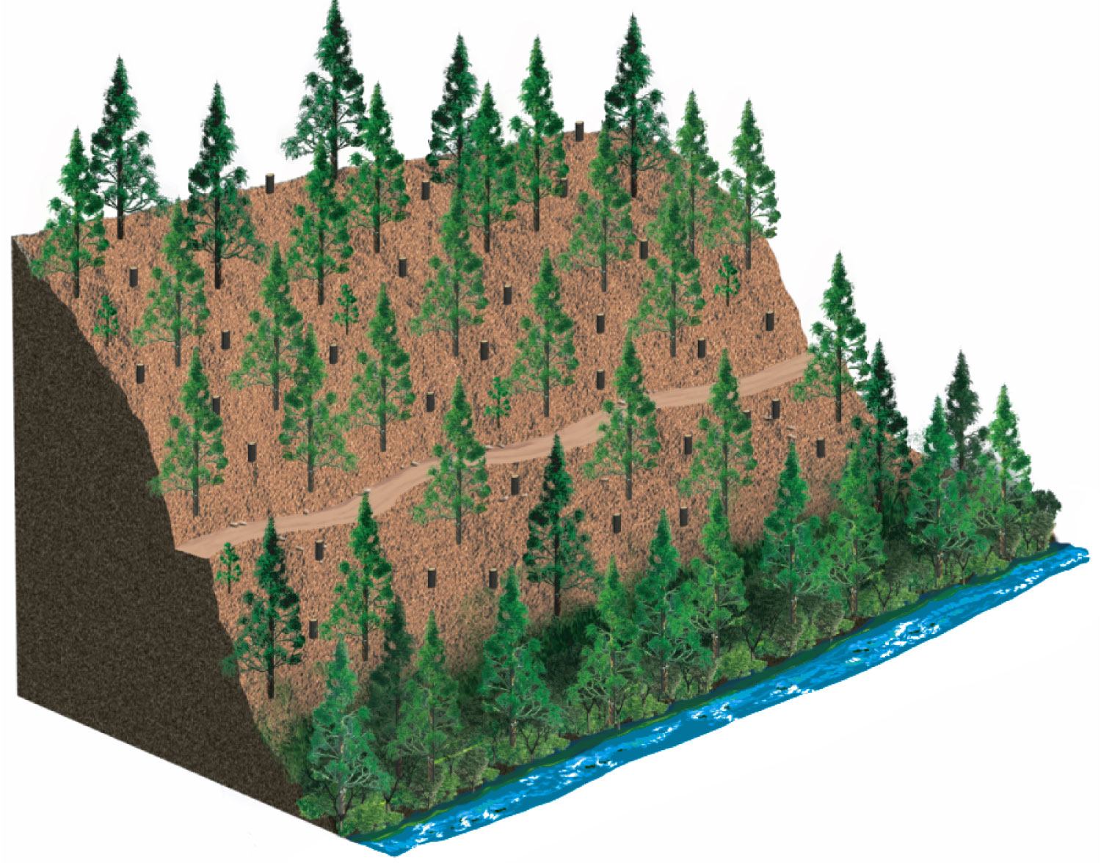
(a) Selective cutting
Clear stream
Fig. 10-6a, p. 222
Notes:
Figure 10.6: This diagram illustrates the three major tree harvesting methods. Question: If you were cutting trees in a forest you owned, which method would you choose and why?

Slide 59
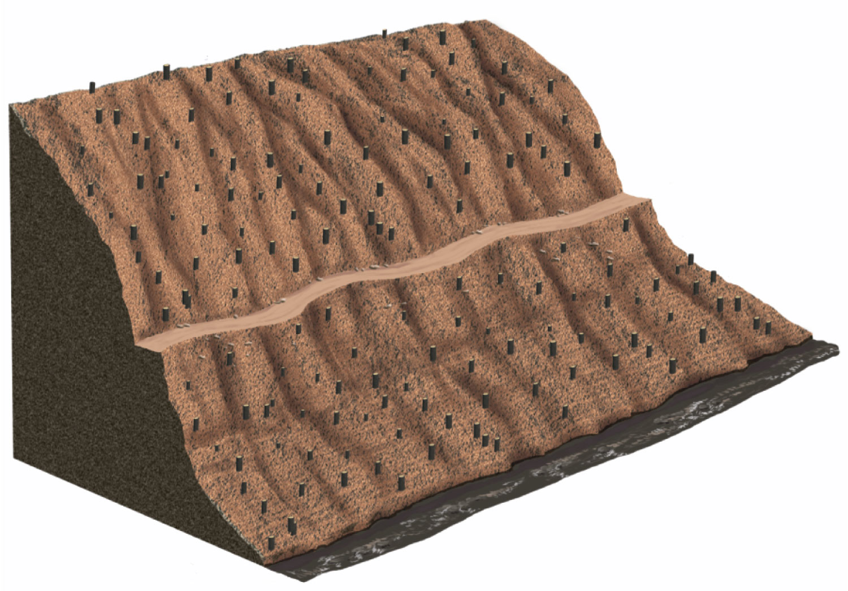
(b) Clear-cutting
Muddy stream
Fig. 10-6b, p. 222
Notes:
Figure 10.6: This diagram illustrates the three major tree harvesting methods. Question: If you were cutting trees in a forest you owned, which method would you choose and why?

Slide 60
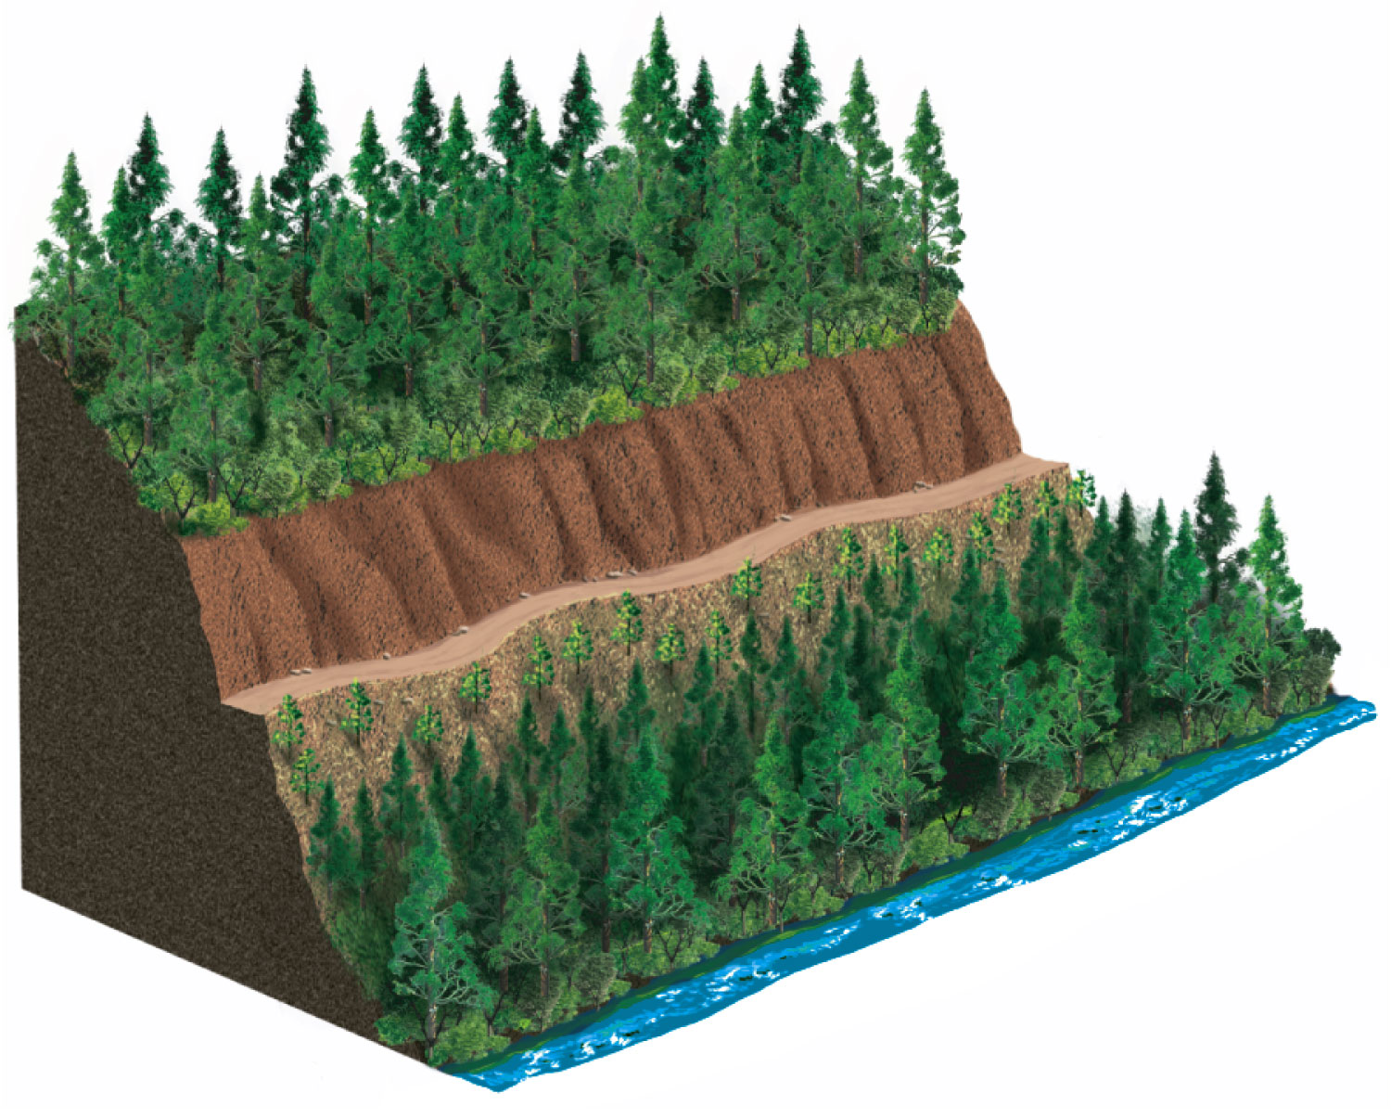
(c) Strip cutting
Cut 1 year ago
Uncut
Dirt road
Cut 3–10 years ago
Uncut
Clear stream
Fig. 10-6c, p. 222
Notes:
Figure 10.6: This diagram illustrates the three major tree harvesting methods. Question: If you were cutting trees in a forest you owned, which method would you choose and why?

Slide 61
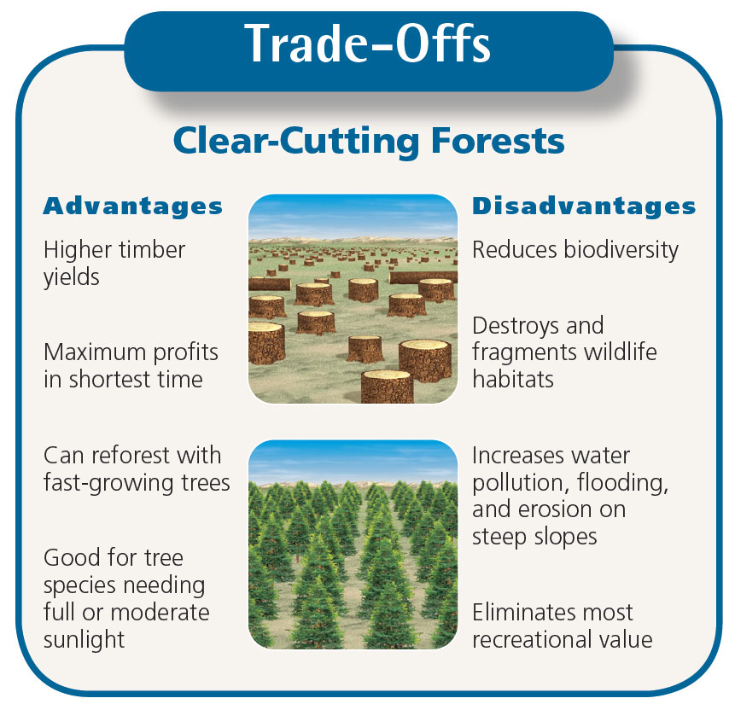
Trade-offs: Advantages and Disadvantages of Clear-Cutting Forests
Fig. 10-8, p. 223
Notes:
Figure 10.8: Clear-cutting forests has advantages and disadvantages. Questions: Which single advantage and which single disadvantage do you think are the most important? Why?

Slide 62
Fire, Insects, and Climate Change Can Threaten Forest Ecosystems (1)
Surface fires
Usually burn leaf litter and undergrowth
May provide food in the form of vegetation that sprouts after fire
Crown fires
Extremely hot: burns whole trees
Kill wildlife
Increase soil erosion

Slide 63
Nonnative Insect Species and Disease Organisms in U.S. Forests
Figure 10, Supplement 8

Slide 64
Causes of Tropical Deforestation Are Varied and Complex
Population growth
Poverty of subsistence farmers
Ranching
Lumber
Plantation farms: palm oil
Begins with building of roads
Many forests burned
Can tilt tropical forest to tropical savanna

Slide 65
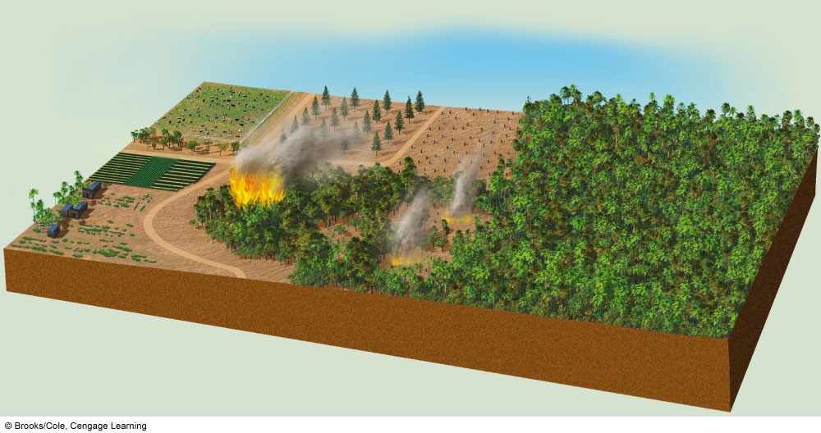
NATURAL CAPITAL DEGRADATION
Major Causes of the Destruction and Degradation of Tropical Forests
Basic Causes
Secondary Causes
• Not valuing ecological services
• Roads
• Cattle ranching
• Crop and timber exports
• Fires
• Logging
• Government policies
• Settler farming
• Tree plantations
• Poverty
• Cash crops
• Population growth
Cattle ranching
Tree plantations
Logging
Cash crops
Settler farming
Roads
Fires
Stepped Art
Fig. 10-14, p. 228

Slide 66
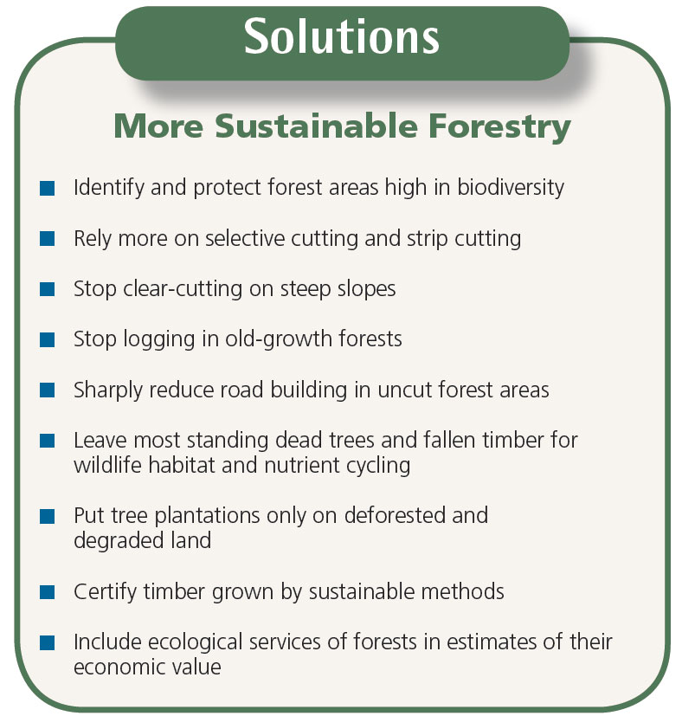
Solution: Sustainable Forestry
Fig. 10-16, p. 230
Notes:
Figure 10.16: There are a number of ways to grow and harvest trees more sustainably (Concept 10-2). Questions: Which three of these methods of more sustainable forestry do you think are the most important? Why?

Slide 67
Science Focus: Certifying Sustainably Grown Timber
Collins Pine
Owns and manages protective timberland
Forest Stewardship Council
Nonprofit
Developed list of environmentally sound practices
Certifies timber and products
2009: 5% of world’s forest have certified to FSC standards
Also certifies manufacturers of wood products

Slide 68
We Can Improve the Management of Forest Fires
The Smokey Bear educational campaign
Prescribed fires
Allow fires on public lands to burn
Protect structures in fire-prone areas
Thin forests in fire-prone areas

Slide 69
We Can Reduce the Demand for Harvested Trees
Improve the efficiency of wood use
60% of U.S. wood use is wasted
Make tree-free paper
Kenaf
Hemp

Slide 70
Governments and Individuals Can Act to Reduce Tropical Deforestation
Reduce fuelwood demand
Practice small-scale sustainable agriculture and forestry in tropical forest
Government protection
Debt-for-nature swaps/conservation concessions
Plant trees
Buy certified lumber and wood products

Slide 71
Solutions
Sustaining Tropical Forests
Prevention
Restoration
Protect the most diverse and endangered areas
Encourage regrowth through secondary succession
Educate settlers about sustainable agriculture and forestry
Subsidize only sustainable forest use
Rehabilitate degraded areas
Protect forests through
debt-for-nature swaps and conservation concessions
Certify sustainably grown timber
Concentrate farming and ranching in already-cleared areas
Reduce poverty
Slow population growth
Fig. 10-19, p. 233
Notes:
Figure 10.19: These are some effective ways to protect tropical forests and to use them more sustainably (Concept 10-2). Questions: Which three of these solutions do you think are the most important? Why?

Slide 72
Some Rangelands Are Overgrazed (1)
Rangelands
Unfenced grasslands in temperate and tropical climates that provide forage for animals
Pastures
Managed grasslands and fences meadows used for grazing livestock

Slide 73
Some Rangelands Are Overgrazed (2)
Important ecological services of grasslands
Soil formation
Erosion control
Nutrient cycling
Storage of atmospheric carbon dioxide in biomass
Maintenance of diversity

Slide 74
Some Rangelands are Overgrazed (3)
Overgrazing of rangelands
Reduces grass cover
Leads to erosion of soil by water and wind
Soil becomes compacted
Enhances invasion of plant species that cattle won’t eat
Malapi Borderlands
Arizona-New Mexico border
Management success story

Slide 75
Case Study: Grazing and Urban Development the American West
American southwest population surge since 1980
Land trust groups: conservation easements
Reduce the harmful environmental impact of herds
Rotate cattle away from riparian areas
Use less fertilizers and pesticides
Operate ranch more economically and sustainably

Slide 76
Case Study: Stresses on U.S. Public Parks (1)
58 Major national parks in the U.S.
Biggest problem may be popularity
Noise
Congestion
Pollution
Damage or destruction to vegetation and wildlife

Slide 77
Solutions: National Parks
Fig. 10-24, p. 239
Notes:
Figure 10.24: These are ten suggestions for sustaining and expanding the national park system in the United States. Questions: Which two of these proposals do you think are the most important? Why? (Data from Wilderness Society and National Parks and Conservation Association)

Slide 78
Designing and Connecting Nature Reserves
Large versus small reserves
The buffer zone concept
United Nations: 553 biosphere reserves in 107 countries
Habitat corridors between isolated reserves
Advantages
Disadvantages

Slide 79
Case Study: Controversy over Wilderness Protection in the United States
Wilderness Act of 1964
Protect undeveloped lands
2% of lower 48 protected, mostly in West
10-fold increase from 1970 to 2010
2009
2 million more acres get wilderness protection
50% increase in length of wild and scenic rivers

Slide 80
Protecting Global Biodiversity Hot Spots Is an Urgent Priority
34 biodiversity hot spots rich in plant species
2% of earth’s surface, but 50% of flowering plant species and 42% of terrestrial vertebrates
1.2 billion people
Drawbacks of this approach
May not be rich in animal diversity
People may be displaced and/or lose access to important resources

Slide 81
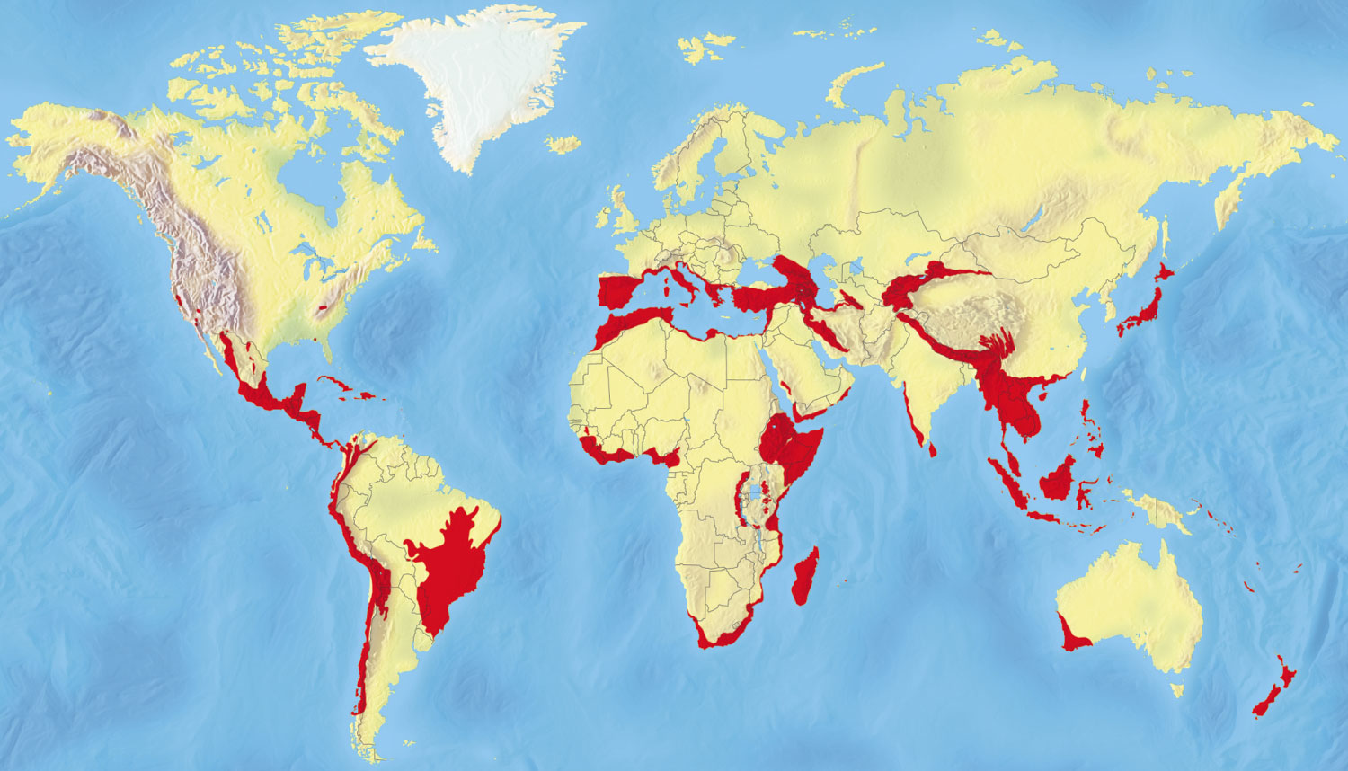
Endangered Natural Capital: 34 Biodiversity Hotspots
Fig. 10-27, p. 243
Notes:
Figure 10.27: Endangered natural capital.
This map shows 34 biodiversity hotspots identified by ecologists as important and endangered centers of terrestrial biodiversity that contain a large number of species found nowhere else. Identifying and saving these critical habitats requires a vital emergency response (Concept 10-5). Compare these areas with those on the global map of the human ecological footprint, as shown in Figure 7, p. S38, in Supplement 8. According to the IUCN, the average proportion of biodiversity hotspot areas truly protected with funding and enforcement is only 5%. See an animation based on this figure at CengageNOW. Questions: Are any of these hotspots near where you live? Is there a smaller, localized hotspot in the area where you live? (Data from Center for Applied Biodiversity Science at Conservation International)

Slide 82
What Can You Do? Sustaining Terrestrial Biodiversity
Fig. 10-28, p. 247
Notes:
Figure 10.28: Individuals matter.
These are some ways in which you can help to sustain terrestrial biodiversity. Questions: Which two of these actions do you think are the most important? Why? Which of these things do you already do?

