Slide 1
Interest Groups and the Political Process
Post-Citizens United

Slide 2
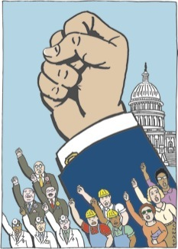
What are Interest Groups?
Organizations of people sharing a common interest or goal that seek to influence government policy and elections

Slide 3
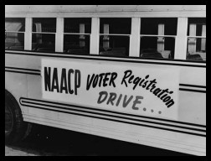
The Role of Interest Groups in the Political Process
Inform public about issues and candidates
Grassroots organizing
Recruit and endorse candidates
Form Political Action Committees (PACs)
Contribute money to campaigns
Sponsor “Issue Ads”

Slide 4
Hard Money:
Campaign contributions regulated and limited by the federal government that are given directly to a candidate

Slide 5
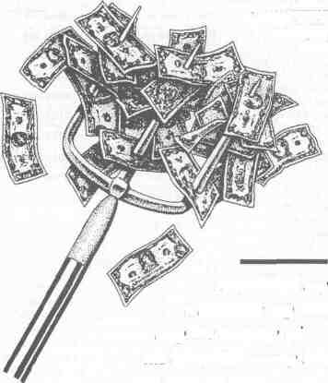
Soft Money:
Previously unlimited and unregulated campaign contributions to federal candidates and the national parties
Supposedly for generic “party building” activities (ex: get-out-the-vote drives, bumper stickers, yard signs, and “issue ads”)

Slide 6
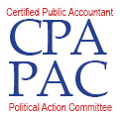
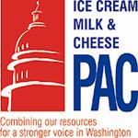
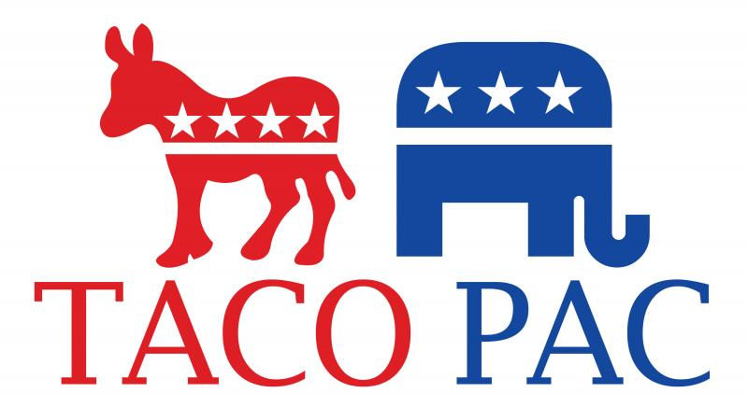
Political Action Committee (PAC):
Officially registered fund-raising organization that represents interest groups in the political process.

Slide 7
Bipartisan Campaign Reform Act of 2002 a.k.a. McCain-Feingold Bill
Prohibited corporations and unions from funding "electioneering communications” within 30 days before a primary or 60 days before a general election
i.e. can’t broadcast ads mentioning a candidate

Slide 8
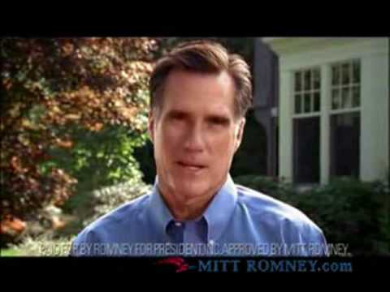
Bipartisan Campaign Reform Act of 2002 a.k.a. McCain-Feingold Bill
Ban on national parties and officeholders raising and spending “soft money”
“Stand by your ad” provision

Slide 9
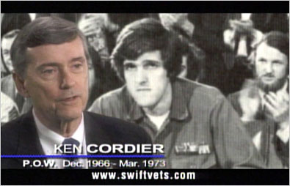
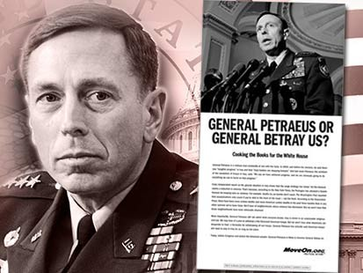
527 Groups
Tax-exempt organizations created to raise money for political activities
Not subject to FEC disclosure rules.
Advocacy groups try to influence federal elections through voter mobilization efforts and so-called issue ads that tout or criticize a candidate’s record.

Slide 10
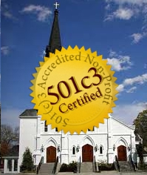
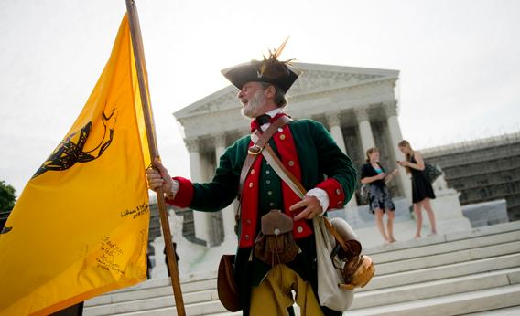
501(c) Groups
Nonprofit, tax-exempt interest groups that can engage in varying levels of political activity
Not subject to FEC disclosure rules.

Slide 11
Campaign Finance Reform
The Supreme Court Weighs In

Slide 12
Buckley v. Valeo (1976)
Spending money to finance campaigns is a form of constitutionally protected free speech through the 1st Amendment
Candidates can spend an unlimited amount of their own money to finance their own campaigns

Slide 13
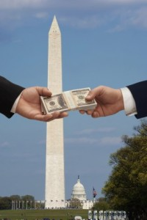
McConnell v. FEC (2003)
Rehnquist Court upheld most of McCain-Feingold a.k.a. BCRA
Restrictions on free speech justified by government’s interest to prevent corruption in campaigns

Slide 14
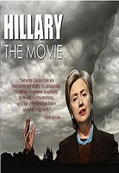
Citizens United v. FEC (2010)
BACKGROUND:
Conservative non-profit produced “Hilary: The Movie”
Purchase airtime on cable TV during 2008 election
FEC deemed movie “electioneering communication” in violation of BCRA

Slide 15
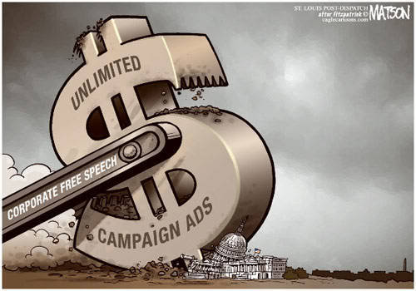
Citizens United v. FEC (2010)
SCOTUS DECISION:
Political spending is protected speech under the 1st Amendment
Gov’t may not keep corporations or unions from spending money to support or denounce individual candidates in elections
Upheld bans on direct contributions to candidates

Slide 16
U.S. constitutional law and corporate law case dealing with the regulation of campaign spending by organizations.
The United States Supreme Court held (5–4) that freedom of speech prohibited the government from restricting independent political expenditures by a nonprofit corporation.
This has been extended to for-profit corporations, labor unions and other associations

Slide 17
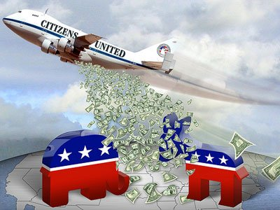
Consequences of Citizens United
Opens flood gates for advocacy spending in campaigns ($1.3 billion in 2012 election cycle)
Disclosure and transparency issues
Paves the way for Super PACs

Slide 18
McCutcheon v. FEC 2014
Collective contribution limits to campaign finance are unconstitutional.
The decision held that a limit on contributions an individual can make over a two-year period to national party and federal candidate committees, is unconstitutional.
Allows even more money into a political process that is pretty well saturated with it.

Slide 19
Prior to McCutcheon v. Federal Election Commission, individuals were prohibited from giving more than
$48,600 combined to all federal candidates.
$74,600 combined to all parties and political action committees.

Slide 20
Does that mean donors can give a candidate as much as they want?
No. The Supreme Court upheld the existing “base” contribution limits.
So what does McCutcheon mean for candidates?
Candidates can now more easily band together and raise big money from the same individuals through legal entities called “joint fundraising committees.”

Slide 21
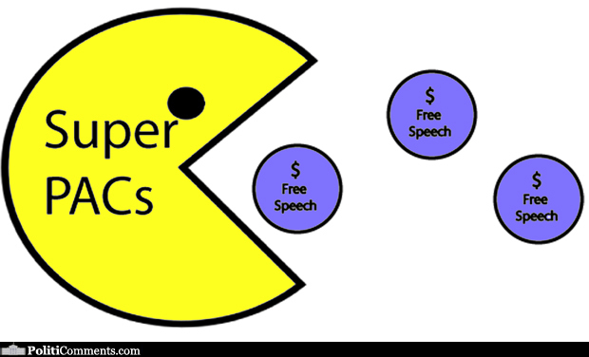
Super PACs
Super PACs may raise and spend unlimited sums of money in order to advocate for or against political candidates.
Super PACs are prohibited from donating money directly to political candidates.

Slide 22
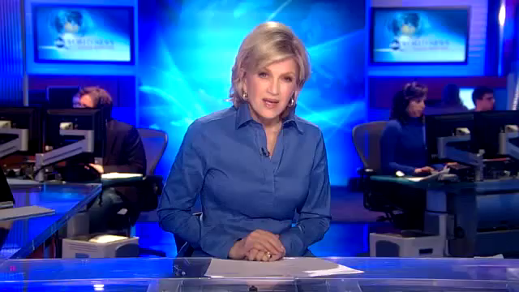
Stephen Colbert’s SuperPAC
Source: http://www.youtube.com/watch?v=AuqSELPyNSo

Slide 23
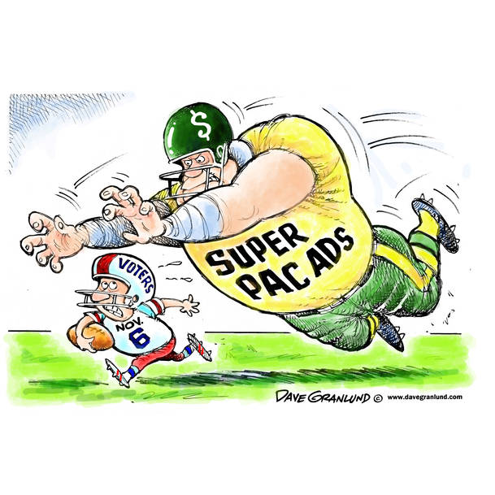
Impact of Super PACs on the 2012 and 2016 Election
Over $1.3 billion spent by 629 outside groups
Only 32% of money spent yielded intended result
**2016 numbers**
As Of Monday, November 14, 2016
2,398 - number of super PACs
$1,574,809,229- total raised by super PACs
$1,117,746,826- total spent by super PACs
Website

Slide 24
Analyzing Political Cartoons
For each of the following cartoons:
Describe what’s going on in the political cartoon (Who? What? When? Where?)
Identify any symbols portrayed in the cartoon and analyze what they represent.
What is the artist’s message in the cartoon? What do you think?
Explain what this cartoon tells us about special interest money in political campaigns after the Citizens United decision.

Slide 25
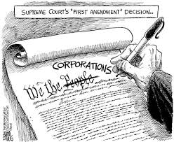
Political Cartoon #1
Source: http://theragblog.blogspot.com

Slide 26
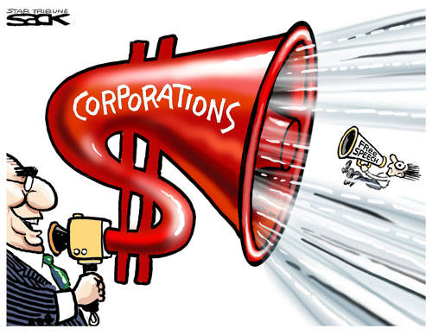
Political Cartoon #2
Source: jobsanger.blogspot.com

Slide 27
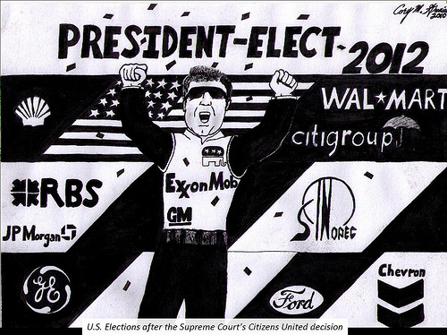
Political Cartoon #3
Source: www.citizenvox.org

Slide 28
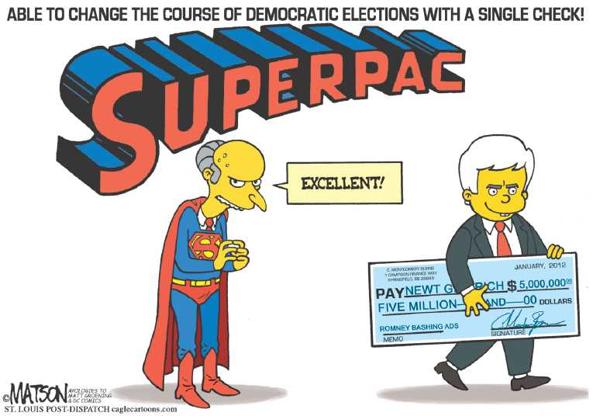
Political Cartoon #4
Source: thecomicnews.com

Slide 29
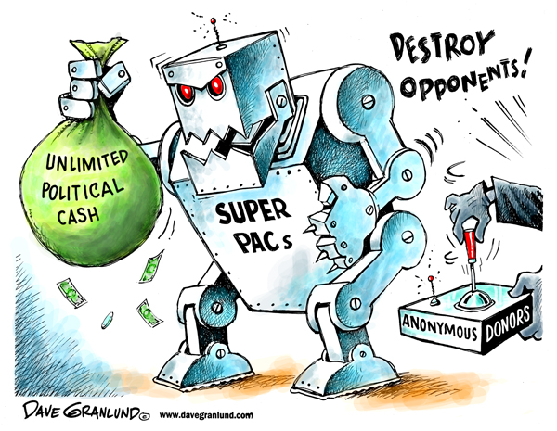
Political Cartoon #5
Source: unitedrepublic.org

