Slide 1
Writing a Literary Analysis
Response #1 on timeline

Slide 2
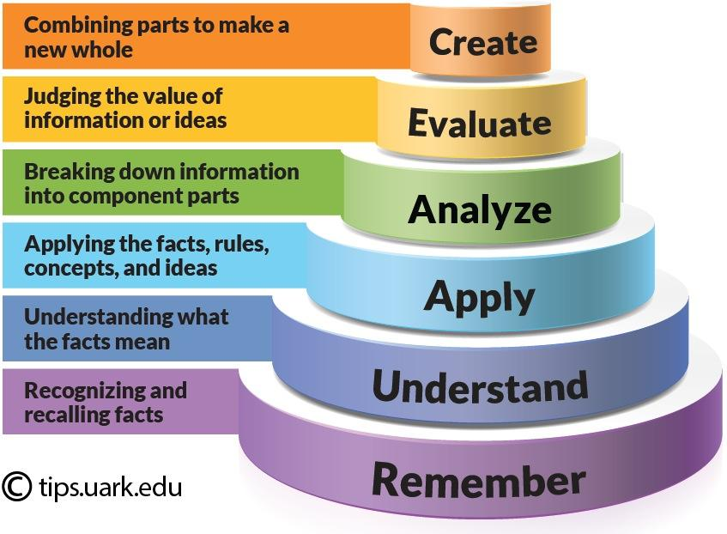

Slide 3
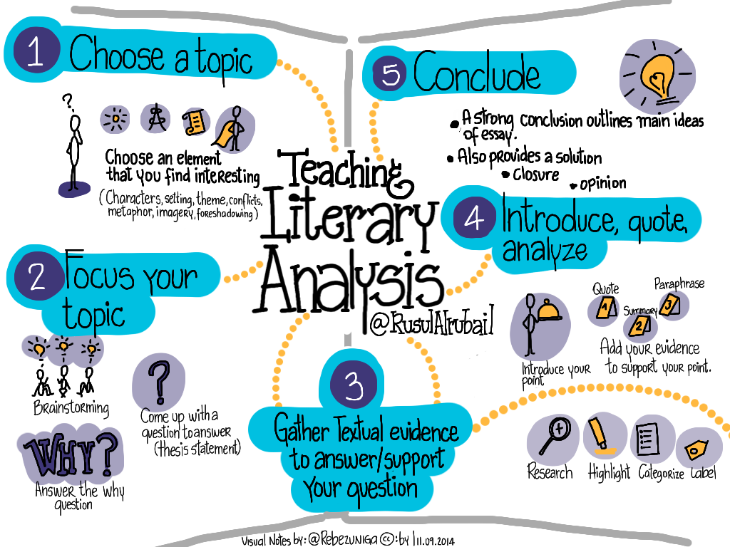

Slide 4
What is Analysis:
An analysis of a literary work may discuss:
A literary analysis is an argumentative analysis about a literary work. ... Instead, a literary analysis discusses a writer's interpretation of a text through careful examination of the author's choices within the text: word choice, themes, motifs, as well as many other literary devices.
How the various components of an individual work relate to each other
How two separate literary works deal with similar concepts, literary devices, or form.

Slide 5
Important Literary Concepts
Characterization
Climax
Flashback
Imagery
Foreshadowing
Metaphor
Narration/Point of View
Personification
Plot
Theme
Setting
Symbolism
Irony/Ambiguity
Handout #1

Slide 6
Writing an Argument:
When writing a literary analysis, you will focus on specific attribute(s) of the text(s).
When discussing these attributes, you will want to make sure that you are making a specific, arguable point (thesis) about these attributes.
You will defend this point with reasons and evidence drawn from the text.

Slide 7
How to write a strong thesis statement

Slide 8
Which is the best Thesis Statement?
Although Moby-Dick is about the problem of evil, it is really about a big, white whale.
Many people believe that Moby-Dick is boring and pointless, but I think it is a good book.
Although Moby-Dick explores good vs. evil, the use of “whiteness” illustrates the uncertainty of the meaning of life that Ishmael expresses throughout the novel.

Slide 9
Secondary Sources:
A book or article that discusses the text you are discussing.
A book or article that discusses a theory related to the argument you are making.
A book or article that discusses the social and historical context of the text you are discussing.

Slide 10
When writing a literary analysis:
Be familiar with literary terms
Analyze specific items
Make an a argument
Make appropriate use of secondary sources.

Slide 12
Step 1:
Briefly summarize(understand) the text:
Include the title of the text, the source, and the author
Give a 5-7 sentence summary. Please no more than 7 sentences. This is meant to be concise.
Briefly outline the main ideas of the book, article or film
should involve who, what, where, when, why and how
you may also choose to discuss the structure, style or point of view
Examples of sentence starters:
This book is about… The author argues that…
The setting is… The research was…
The main character… The main points are…The theme….
Choose an element to focus your topic:
Brainstorm, answer the question why, come up with a question to answer =THESIS STATEMENT
Response #1 Handout

Slide 14
Bloom's Understand (Summary)

Slide 15
Step 2:
Analyze (or break down) the author’s argument:
What was the author trying to prove (his/her thesis)?
Did the author successfully prove his/her argument? How do you know? You may ask yourself:
Did the author use evidence? If so, what kind of evidence?
Did the author give enough evidence?
Did the author’s argument appear overly biased?
Refer to at least two points in the author’s work to support your opinion, using either quotes or paraphrases. (You do not need to cite your source at this point.)
To write an analysis, you need to think about how each part of something contributes to the success of the whole.
Caution! Make sure that you're NOT just summarizing the original article, story, novel, poem, etc. Go beyond simply telling us WHAT you are talking about: describe HOW and WHY its elements function.
Understand/Summarizing = WHAT Analyze = HOW & WHY

Slide 16
Bloom’s Analyze

Slide 17
Step 3:
Evaluate (or judge)/Conclude the author’s argument: Add your evidence to support your point
Closure
Opinion
Do I agree or disagree with the author’s argument? Why or why not?
You may ask yourself:
Did the author give adequate reasons/evidence for his/her argument?
Why is this point important?
Was the author’s work complete? Or should he/she given more evidence? If so, what kind?
Give at least two reasons for your response. Again, refer to the article to back up your opinion, using either quotes or paraphrases. (You do not need to cite your source at this point.)

Slide 18
Bloom’s: Evaluate

